Slide 1




Recruitment Strategy
Business Analytics in Excel

Slide 2
GOALS
The Whitman School of Management school has seen an increase in the number of international student enrollment.
The goal of this report is to analyze the data from the past years and provide inputs on how the program can be further refined.
The ultimate aim is to increase participation and its reach, while managing to stay within the program budget.

Slide 3
AVAILABLE DATA INPUTS
Average GMAT scores
US government education department program locations
Past recruitment event data
Global Trends on a country level, region-wise and on a continent level
Existing Alumni Data

Slide 4
WHAT DEFINES SUCCESS?
Increase in Whitman recruitment event participation
Increase in interaction with the Whitman recruitment officials
Staying within the budget
Increasing the Average GMAT score in the incoming batch
Expanding the marketing funnel or identifying new locations

Slide 5
CONTINENT TRENDS
Number of students who have been taking GMAT exam have been levelling out.
South America trends show that there is slight increase in the year 2017
North American and Asian continents have the largest chunk of students who take the exams

Slide 6
COUNTRY TRENDS
The top 5 countries from where the maximum number of GMAT takes are from China, India, Canada, Germany and UK

Slide 7
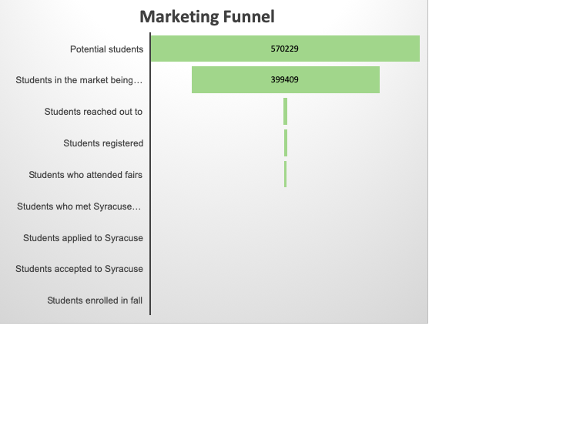
MARKETING FUNNEL
Potential students | 570229
Students in the market being pursued | 399409
Students reached out to | 9184
Students registered | 7846
Students who attended fairs | 5639
Students who met Syracuse recruiters | 811
Students applied to Syracuse | 58
Students accepted to Syracuse | 30
Students enrolled in fall | 10

Slide 8
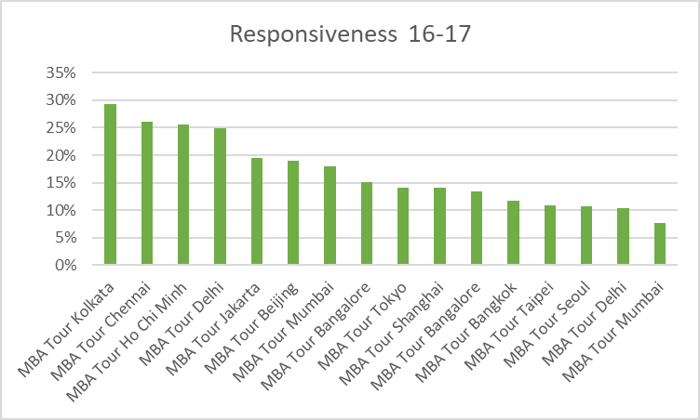
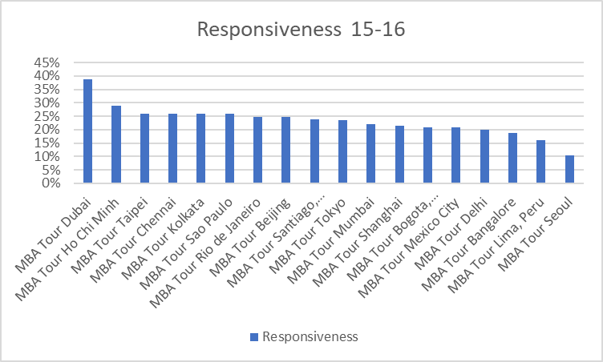
NARROWED DOWN MARKETING FUNNEL
The funnel was further narrowed down by –
Observing the number of people who registered for the events
Number of people who came in the event
Number of people who met the Syracuse recruiters from the event data of 2016-2018

Slide 9
SUGGESTIONS
If the budget were to reduce, we would drop the cities where the response was the least. Hence, we would drop Seoul and Delhi
If the budget were to increase, we would add London and Berlin

Slide 10
THANK YOU

